Slide 1
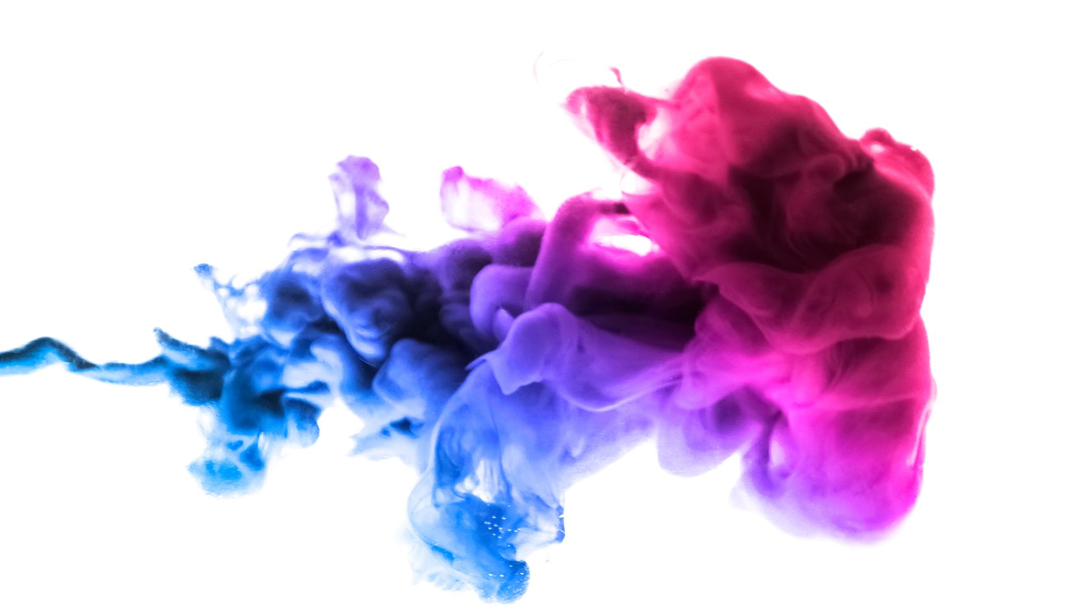

Innovision

Slide 2

TEAM INNOVISION
We are Team Innovision. We are the team responsible for creating instructions for the lights in the media lab. With our help, you will become a pro at setting up the lights however you want.

Slide 3
CURRENT SITUATION
Students don't know how to use the lighting in the Pixel Playground
Why? There aren't any tutorials or manuals available (informative guidelines*)
This could lead to problems and high costs
We want to resolve this issue

Slide 4
OBJECTIVES
Creating easy to understand tutorials
Having them on paper + video tutorials
Adding visuals to the tutorials
Informing students of proper safety

Slide 5
BENEFITS OF CLEAR MANUALS
Good manuals reduces overal confusion about the equipment
With warnings, awareness is raised.
Accessible to almost anyone.
Clear manuals promote careful use of fragile equipment.
Improves the quality of life of teachers by reducing repetitive explanations.

Slide 6
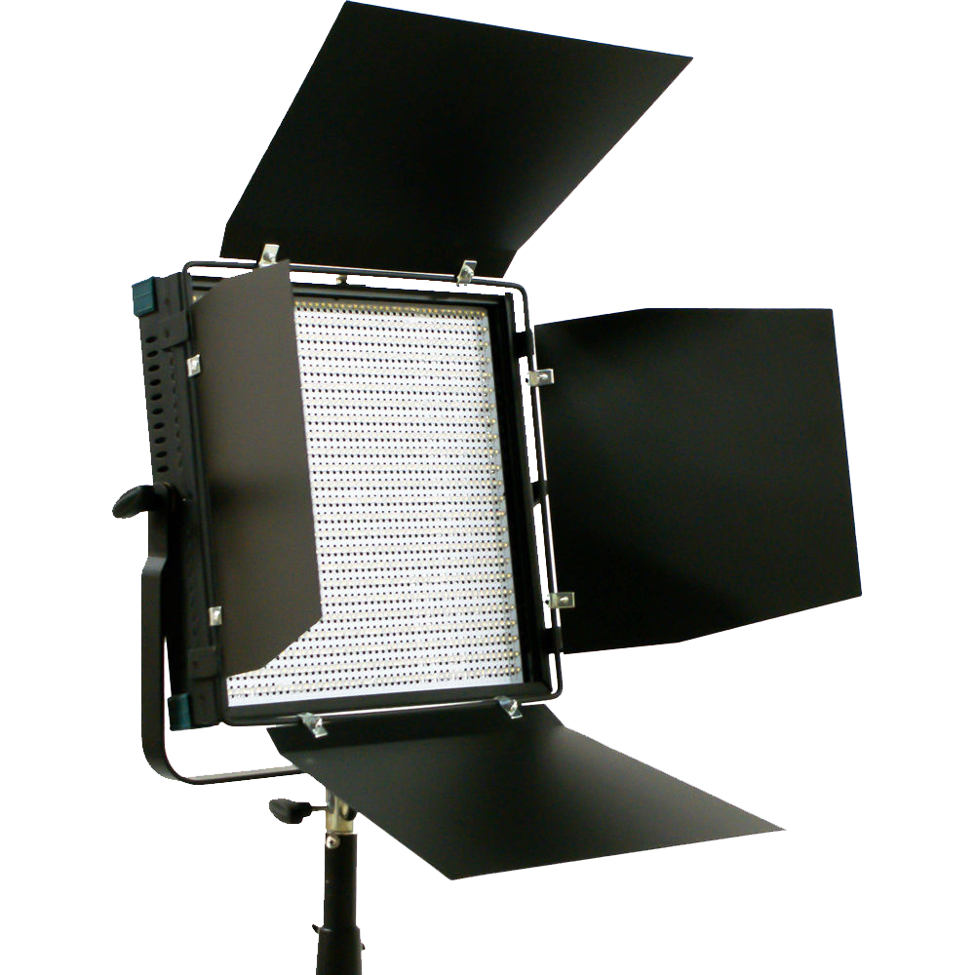
PROPOSED SOLUTIONS:
We intend to pass off proper safety knowledge
Video tutorials for visual learners
Short descriptions including key info
Long in-depth descriptions to cover all info
Step by step for ease of setup of the lights

Slide 7
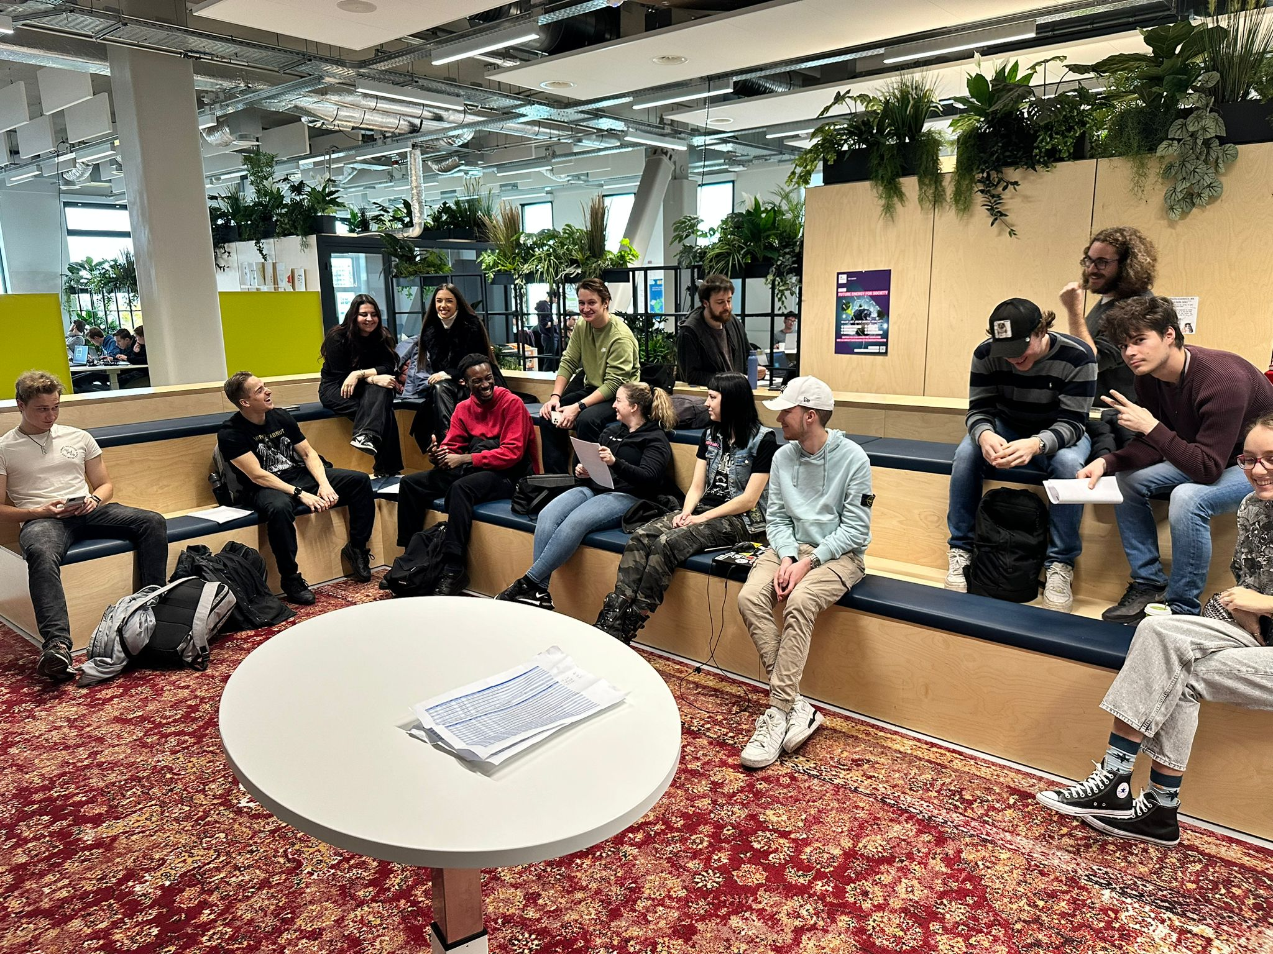
IMPORTANT MEETINGS
The innovision team has attended meetings to discuss with other groups
We asked for recommendations, and gave the other groups our own input.
This helped us create the style guide everybody has to follow

Slide 8
SAFETY FIRST
We want to emphasize the dangers of the different lights and Including their corresponding warnings.
This reduces the risk of the lights breaking or the users hurting themselves.
By adding the safety it also adds to financial safety to pixel playground since the lights will be handled with care, therefore increasing longevity and reducing the need to buy new equipment every year.

Slide 9
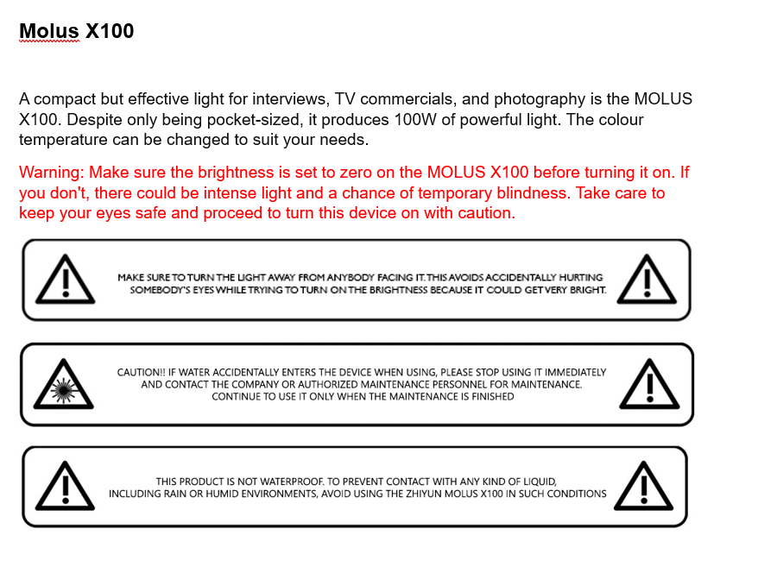
Manual components
The manual starts off with warnings (user awareness)

Slide 10
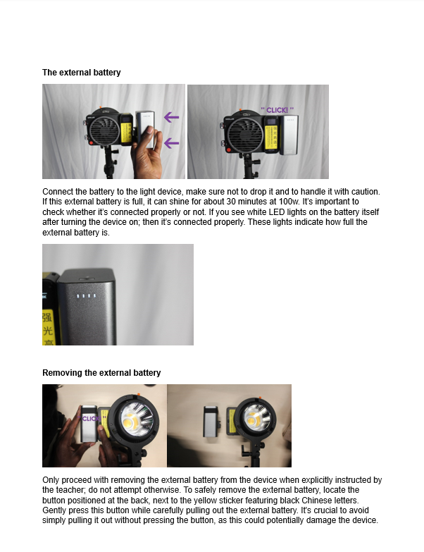
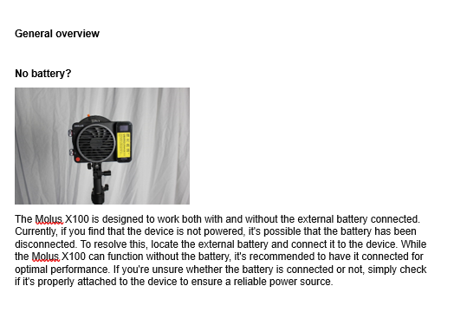
Manual components
Then it gives an general overview with pictures of the light device

Slide 11
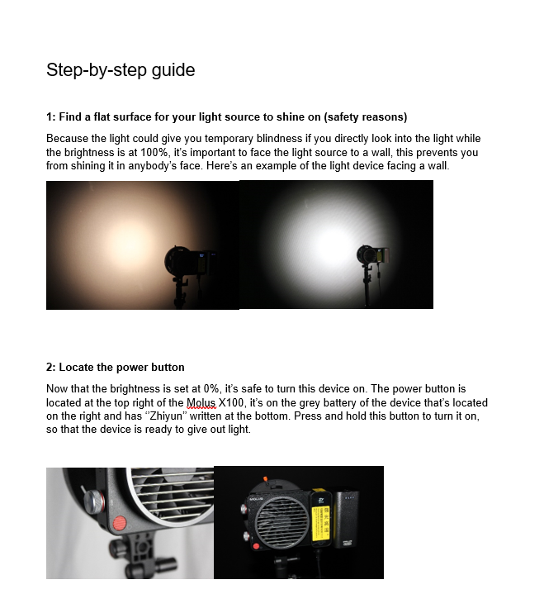
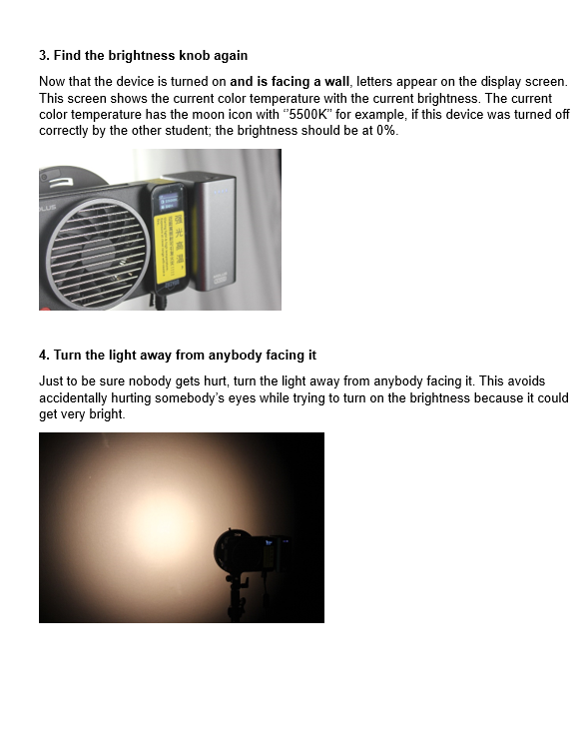
Manual components
It then explains the user step-by-step how to use a certain light device

Slide 12

User-Friendly Design:
The front page gives a basic explanation of the manuals purpose
Table of contents for accessibility and ease of navigation
Short description for key features
Long description for in-depth analysis
Borders in the colors of the Pixel Playground branding

Slide 13
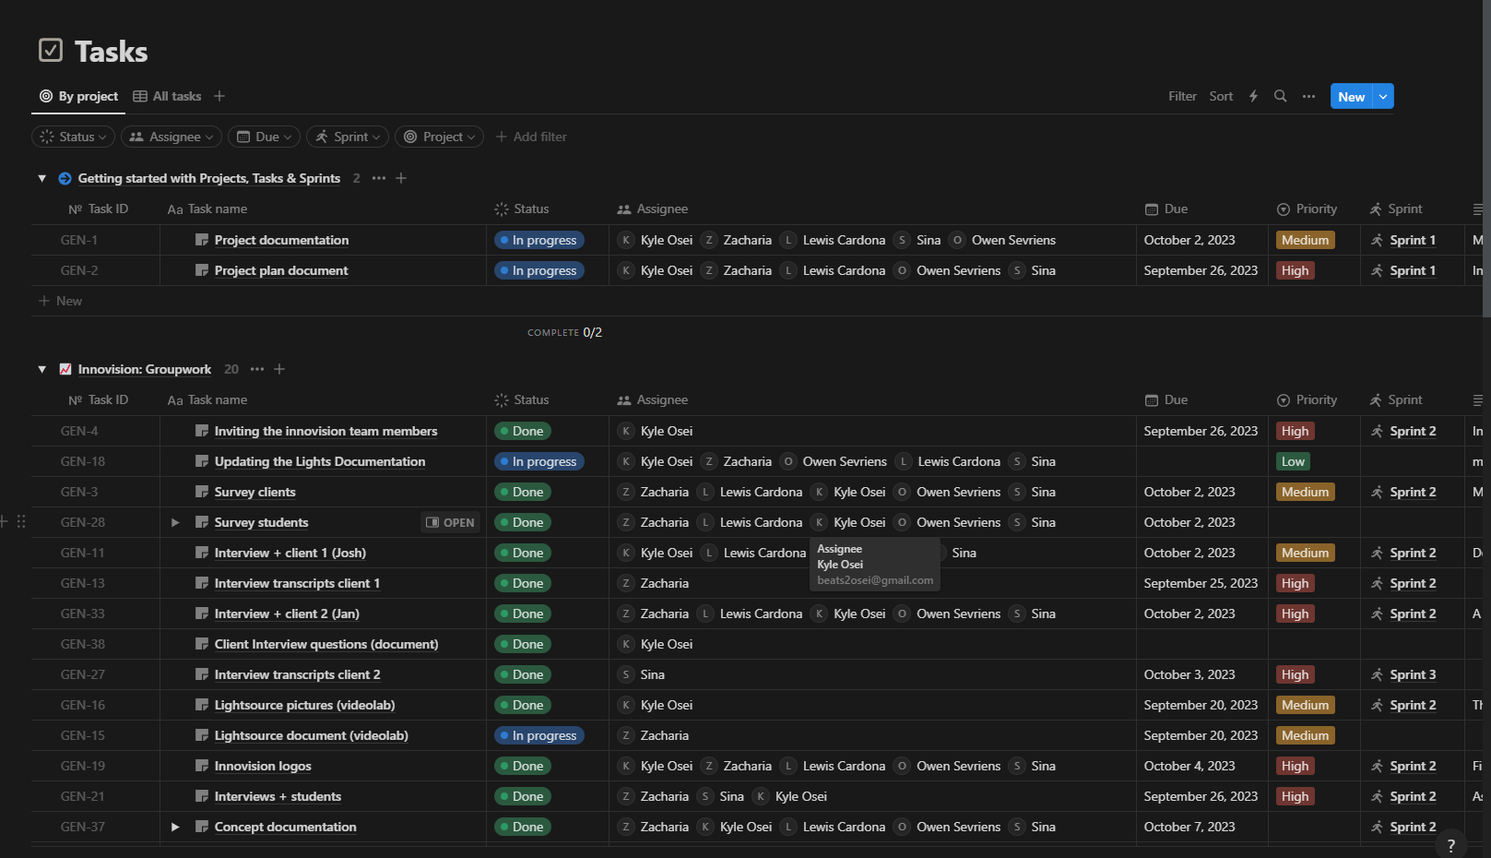
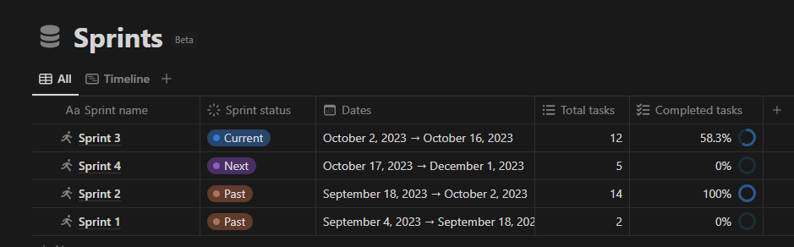
Timeline
Because of Notion, we're able to display our timeline with all the tasks from start to finish

Slide 14
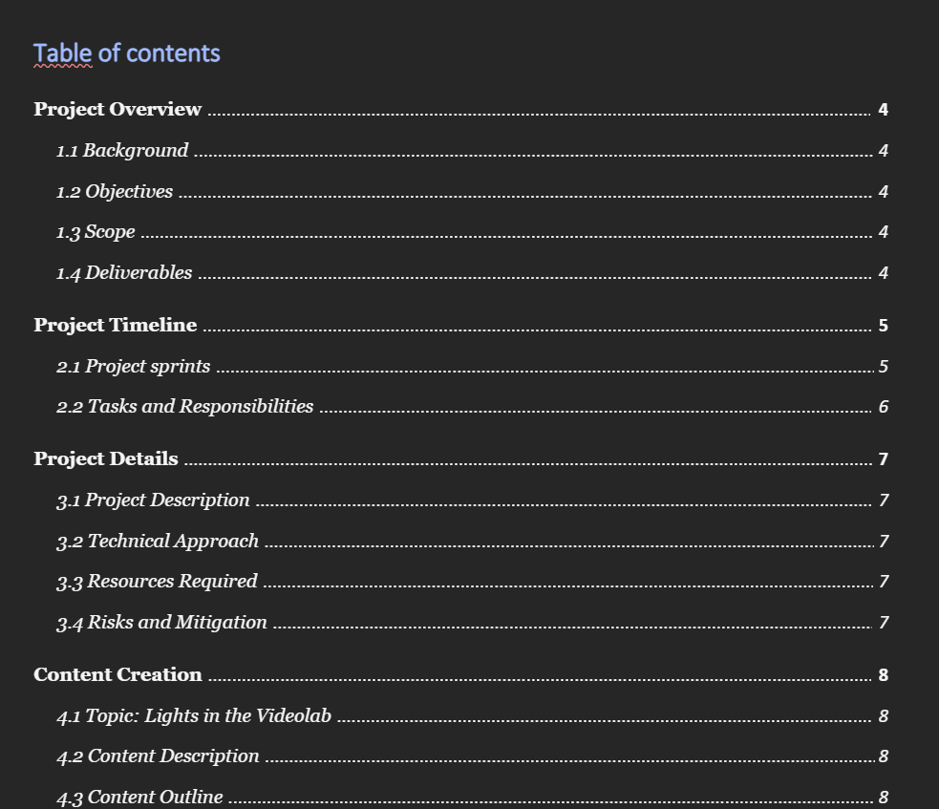
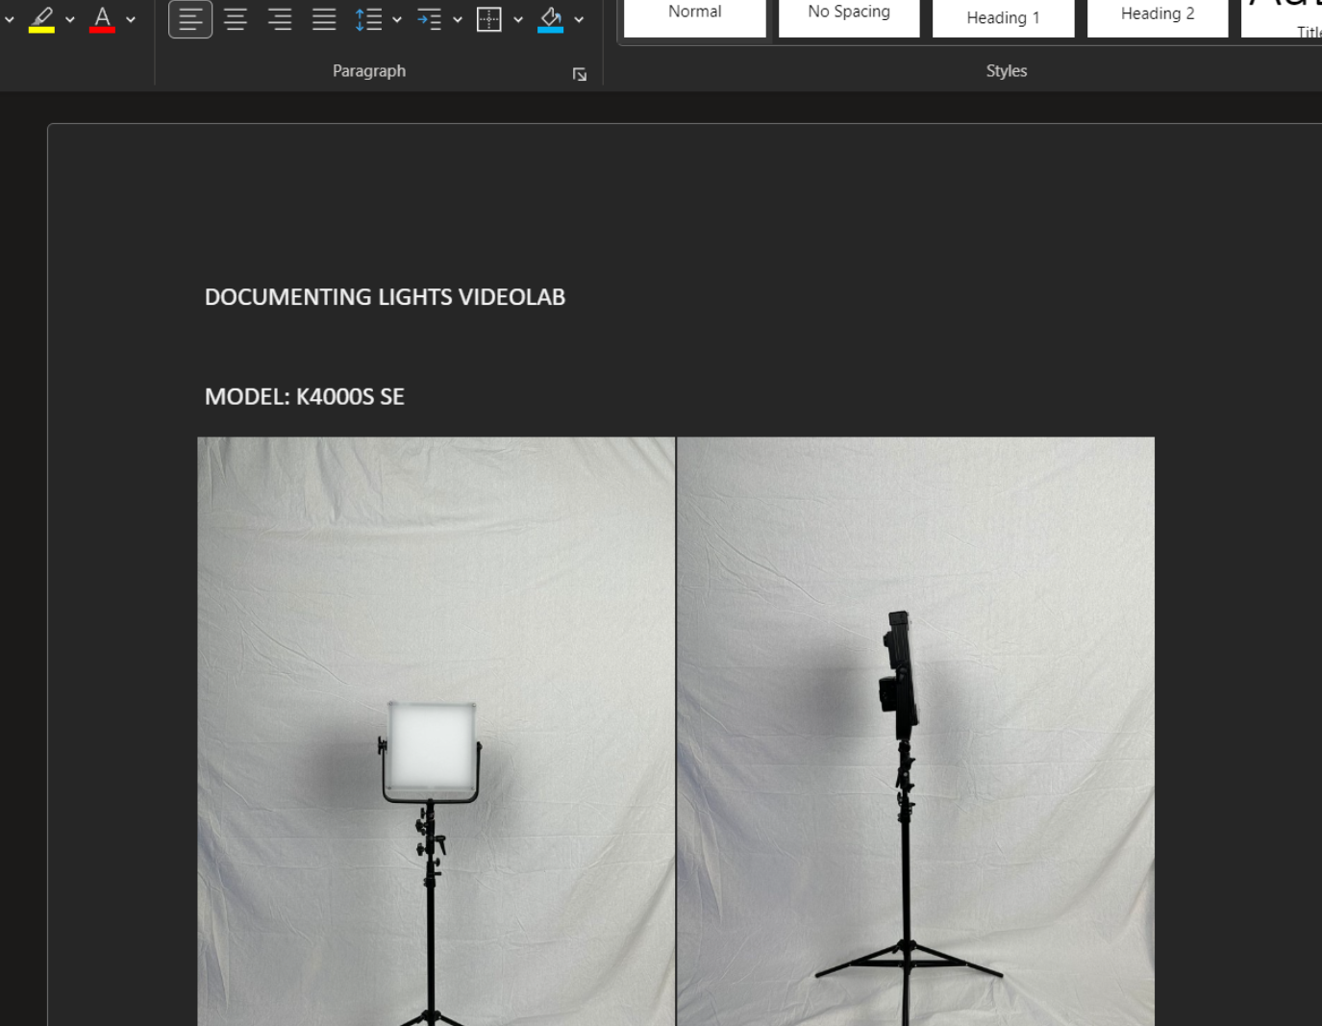
documentation
In order to keep everything in check, we make sure to update our documentation about the project as we go through the semester. This way, we know if we are on schedule with where we have to be.

Slide 15
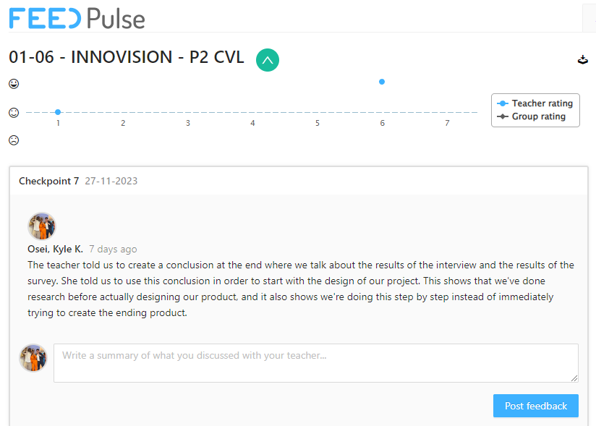
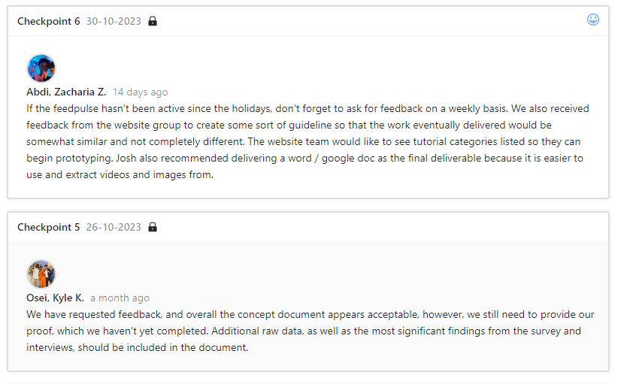
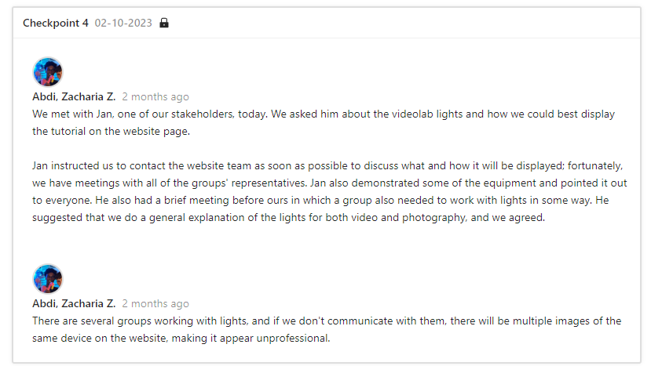
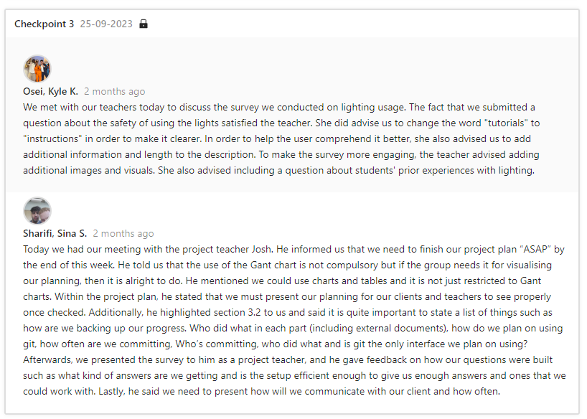
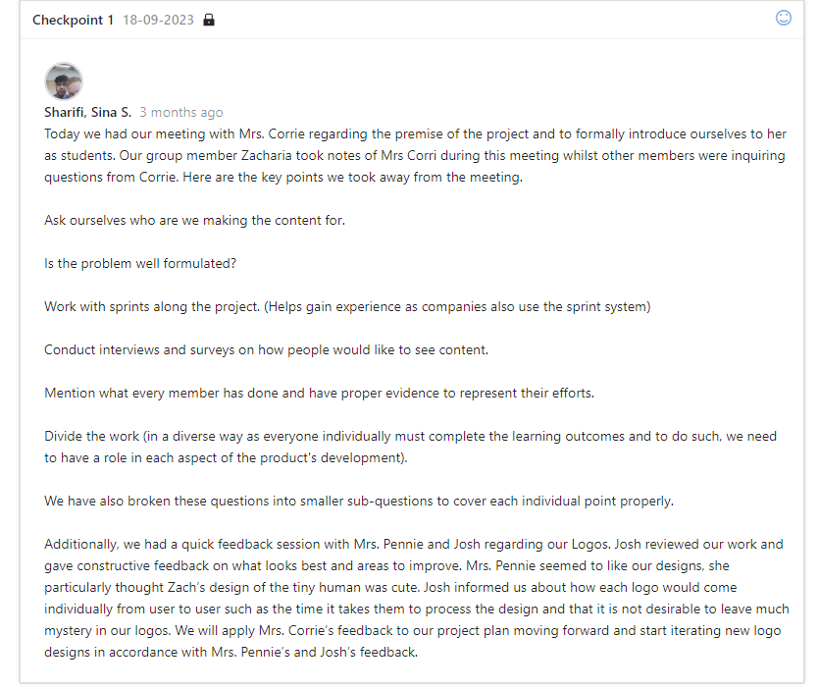
Feedback
During this semester, we've made Feedpulse checkpoints regularly to document our feedback and process.

Slide 16
Future plans
Creating video's that make the manuals even more clear
Making high quality audio recordings for the video
Putting the manuals into the template that follows the style guide (pdf)

Slide 17
Summary
Students don’t know how to use the Pixel Playground to it's full potential.
We plan to make video & text tutorials for the light system.
we ensure that students are made aware of the warnings and dangers so the teachers dont have to keep an eye out at everytime.
Notes:
When we conducted our interviews, we concluded that students were unfamiliar with the proper usage of the Pixel Playground. Consequently, we decided to simplify the learning process for them. To achieve this, we created easy-to-follow video and text tutorials, complete with voiceovers and clear images. Importantly, we prioritized safety throughout the tutorial creation process. Our focus extended beyond protecting the equipment; we also ensured that users are safeguarded against potential harm.

